Slide 1
Asteroidal Occultations: Profiles, 3D-Models, discoveries, and data archiving
Dave Herald

Slide 2
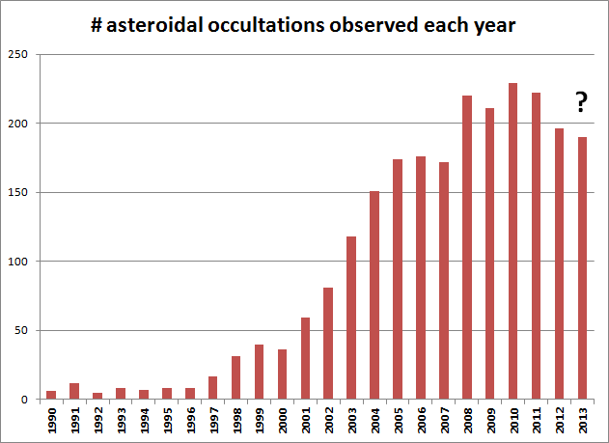
About 200 events each year

Slide 3
Number of successful events by region, and max # sites: 2012/07 2013/08
Australasia 64 (11 sites)
Europe 65 (34 sites)
Japan 21 (14 sites)
US 77 (11 sites)

Slide 4
Discoveries from asteroidal occultations
moons of asteroids
new double stars
Rings around (10199) Chariklo

Slide 5
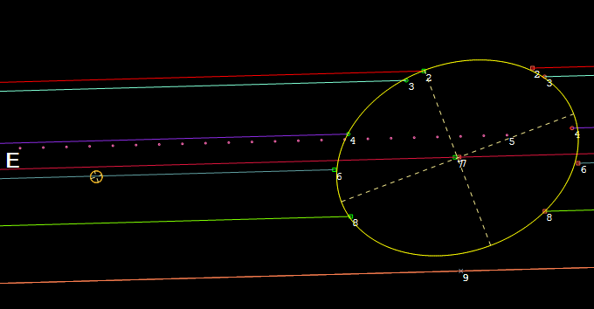
Satellite discovery #1 Agamemnom – 2012 Jan 19

Slide 6
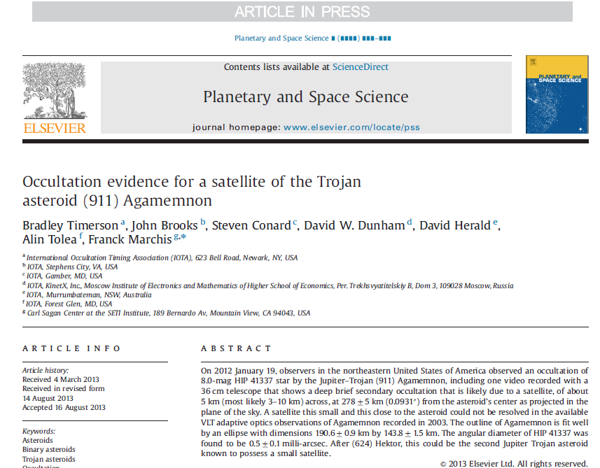
Paper in major astronomical journal

Slide 7
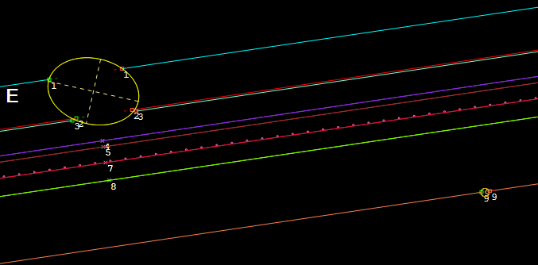
Satellite discovery #2 (2258) Viipuri – 2013 Aug 3 (?? - single integrated frame event)

Slide 8
Double stars discovered in asteroidal occultations
New double stars can be discovered in an asteroidal occultation
Separations are usually in the range 0.1” to 0.001”
If several observers, the uncertainty in separation can be less than 1 milli-arcsecond [ <0.001”]

Slide 9
7 double stars discovered since June 2012
Star number Sep (mas) P.A. Date Asteroid
6223-00442-1 37.8 -69.8 2012 Aug 12 52 Europa
HIP104465 9.2 ± 0.8 171.5 ± 1.2 2012 Nov 25 168 Sibylla
2U42913552 28.2 ± 0.5 107.6 ± 3.6 2012 Dec 3 388 Charybdis
2U46691743 43.0 ± 0.6 237.0 ± 1.2 2013 Jan 27 536 Merapi
1950-00148-1 28.3 ± 0.4 12.3 ± 0.8 2013 Feb 6 92 Undina
6258-00144-2 1.0 -4.0 2013 Jul 24 1271 Isergina
2U30429828 380.0 240.0 2013 Aug 15 611 Valeria

Slide 10
Valeria - 2013 Aug 15 Wide double star (380mas) Time diff: 66 secs Chris Chad, Gunnedah

Slide 11
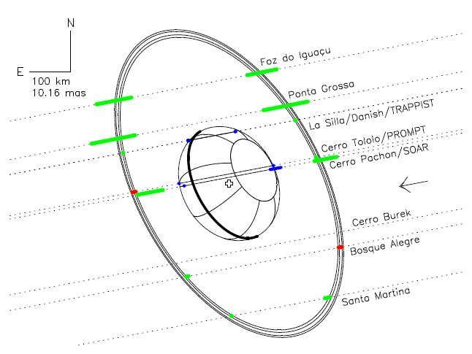
Rings around (10199) Chariklo
1982
Discovery - 2013 June 3
1986
1997
2007
2014
2018

Slide 12
Light curve inversion
Irregular shape causes rotational light curve variation
When polar axis is inclined to the ecliptic, the parts of the asteroid that are ‘visible’ varies, depending on location in orbit
Can model the shape of the asteroid using the differing light curves – called ‘inversion models’

Slide 13
Requires accurate measurement of the rotation period, and determination of the direction of the axis of rotation
The model gives a shape for the asteroid, but not its size
Most models currently are limited to convex surfaces
Usually two models fit the available data

Slide 14
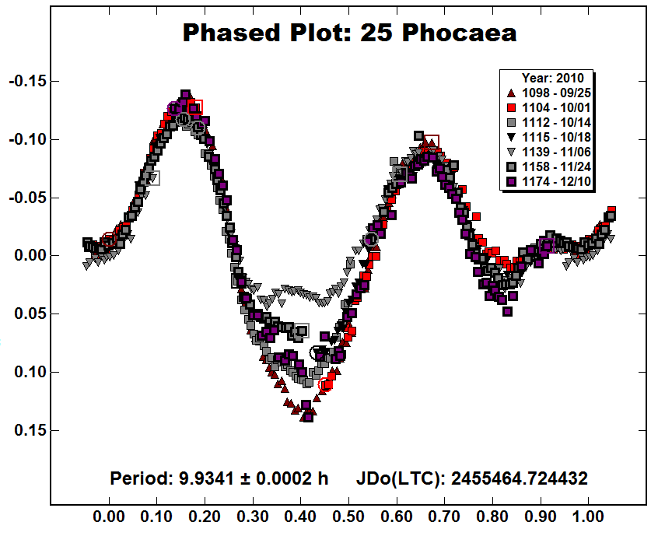
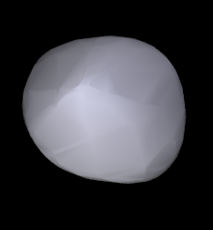
Light curve analysis
3D model

Slide 15
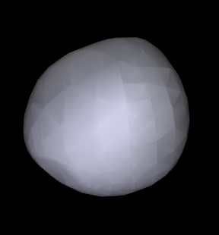
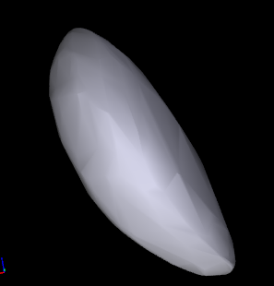
Some other shape models
Pallas
Geographos

Slide 16
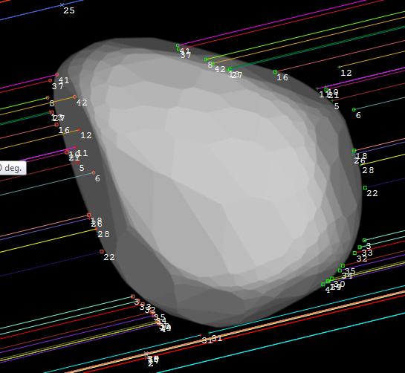
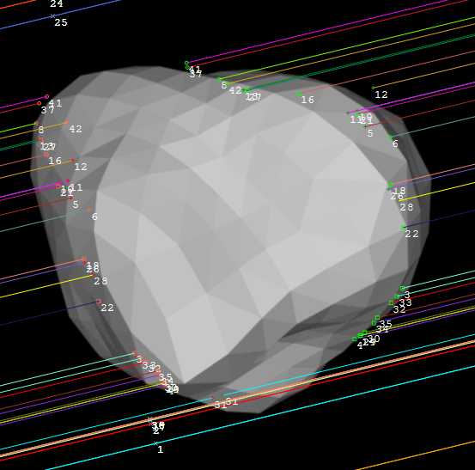
Eliminate models
(9) Metis 2014 Mar 7
Model 1 ✓
Model 2 ✗

Slide 17
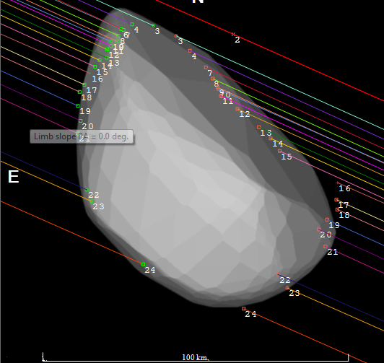
Precise dimensions
(135) Hertha 2008 Dec 11

Slide 18
Reporting & Archiving observations
Currently over 2,500 asteroidal occultation events observed,
14,290 observations (many of which were miss observations)
Average of 6 observers per event

Slide 19
Data collection
World divided into 4 main observing regions
Australasia
Europe
Japan
North America

Slide 20
Regional coordinators
Observers send observations to a ‘regional coordinator’ for their region, who:
collates the observations into a single file;
Checks the data for consistency/errors etc
Publishes results on a ‘local’ web site
Forwards the observations to a Global Coordinator

Slide 21
Global coordinator
Keeps an eye out for problem observations
Adds the observations to a consolidated file
Makes the updated file available to all users of Occult (global data backup!)
Periodically sends a report of astrometry derived from occultations to the Minor Planet Centre – with all associated observers being named, and included in the SAO/NASA ADS [Astronomical Data System]

Slide 22
Sample astrometry report

Slide 23
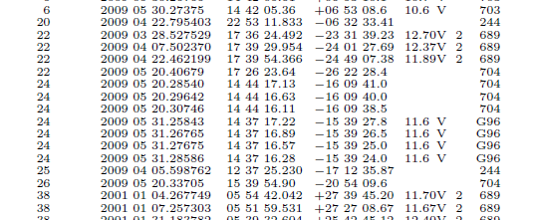
Example publication of astrometry

Slide 24
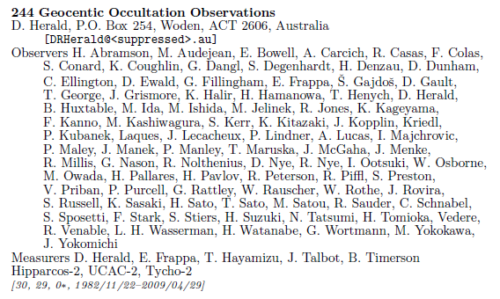
Example summary report in Minor Planet Circulars

Slide 25
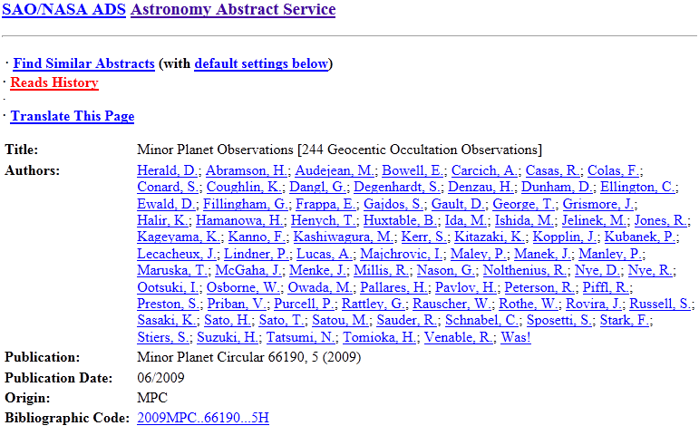
Example ADS entry

Slide 26
Archiving at NASA’s Planetary Data System [PDS]
All observations archived each March at PDS – small bodies node
Data has to be reformatted to meet PDS formatting requirements (Numeric data fields must have a character at each location in the field)
Dataset goes through a comprehensive review process

Slide 27
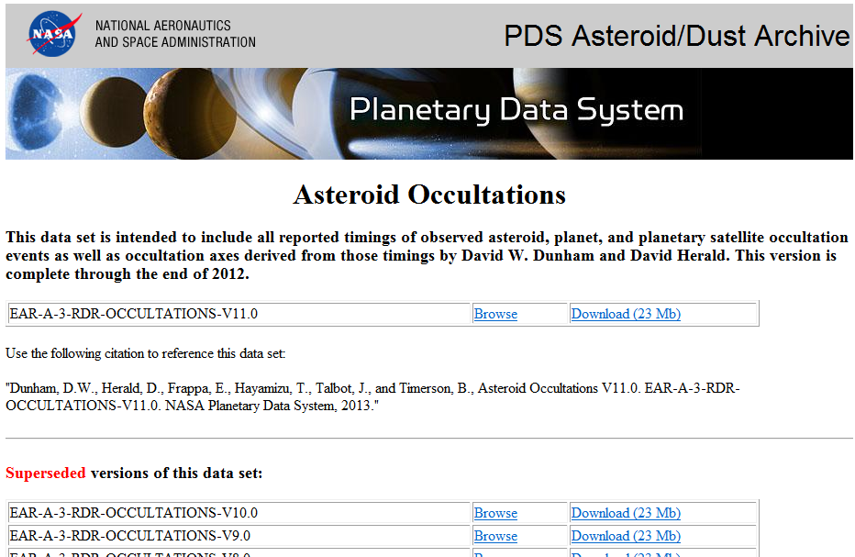
http://sbn.psi.edu/pds/resource/occ.html

Slide 28
Any questions?

